Slide 1



Data Analytics and Programming
Group F
Mustafa Sayin – 23174773
Mustafa Karaburun - 23216158

Slide 2

Introduction
Traffic Accidents
Traffic Count
Data Preparation
Databases
Visualization

Slide 3

Research Questions
Highest number of injured people
Vehicle was involved in more accident
Relationship between Road Length and Traffic Count
Traffic Count according to Road Type

Slide 4

Datasets
Annual Average Daily Traffic (2019)
2019 Collisions in NYC

Slide 5
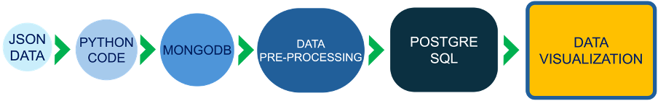
Methodology

Slide 6
Data Cleaning and Preprocessing
Dropped irrevelant features(Column with many Null value
Filling the missing value with appropriate value.
Remaping the some variables in datasets.

Slide 7
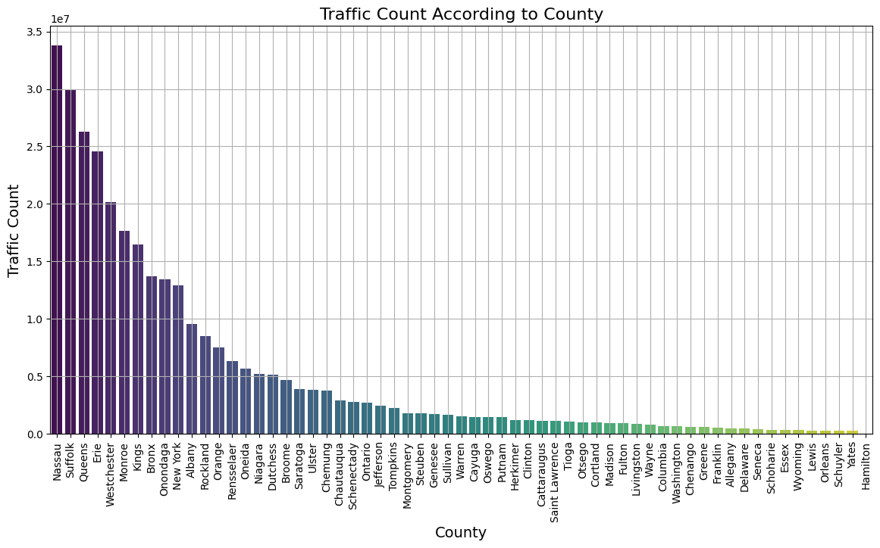
Annual Average Daily Traffic (AADT)

Slide 8
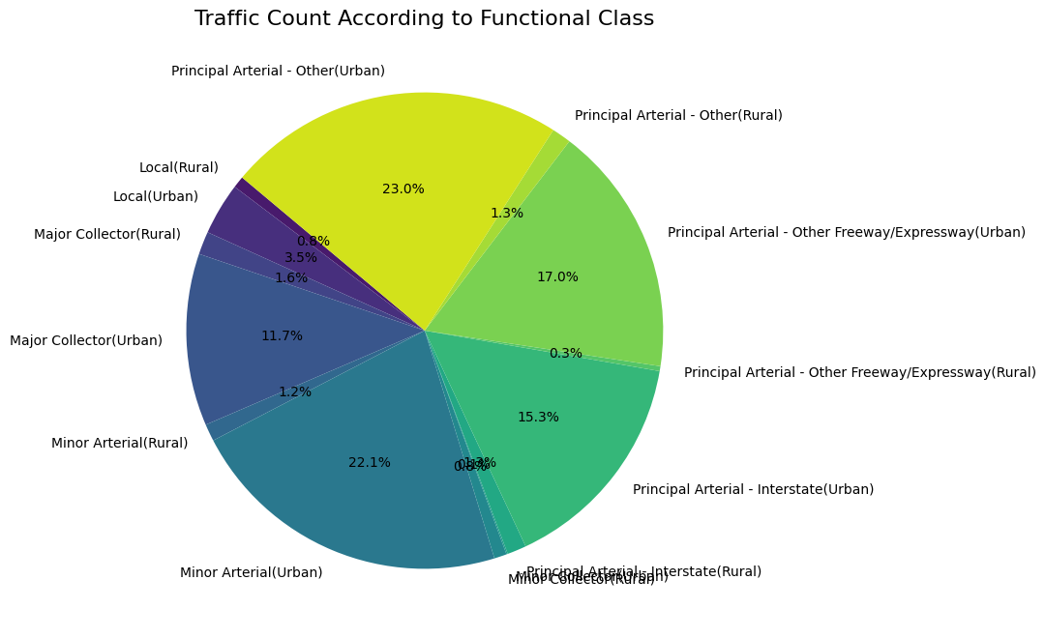
Annual Average Daily Traffic (AADT)

Slide 9
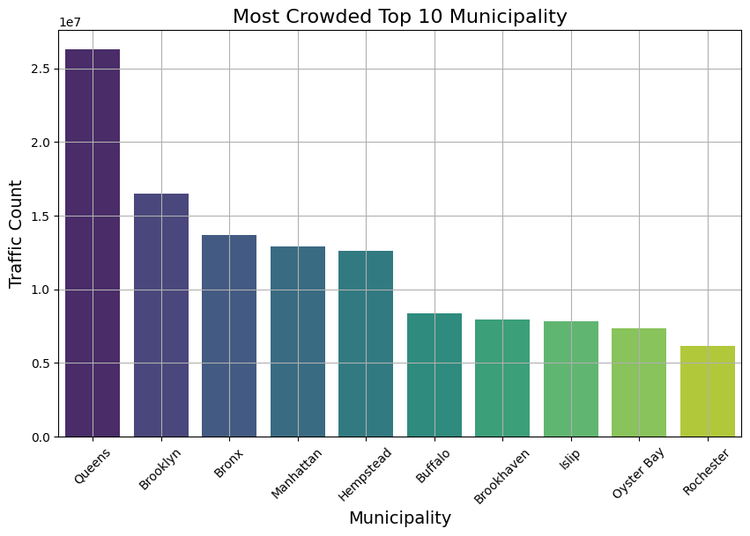
Annual Average Daily Traffic (AADT)

Slide 10
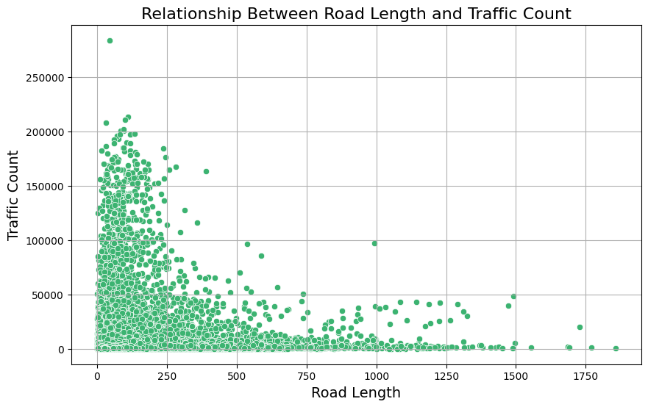
Annual Average Daily Traffic (AADT)

Slide 11
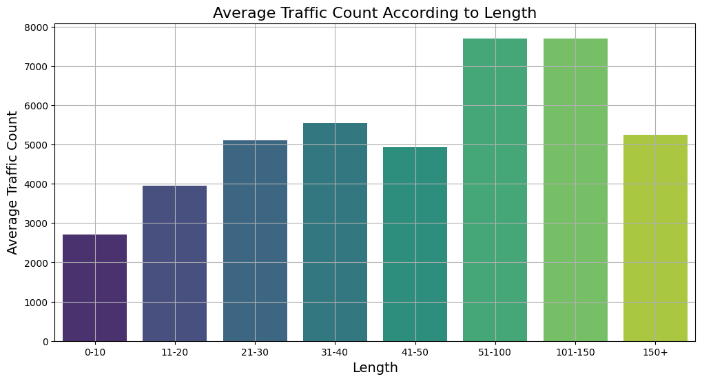
Annual Average Daily Traffic (AADT)

Slide 12
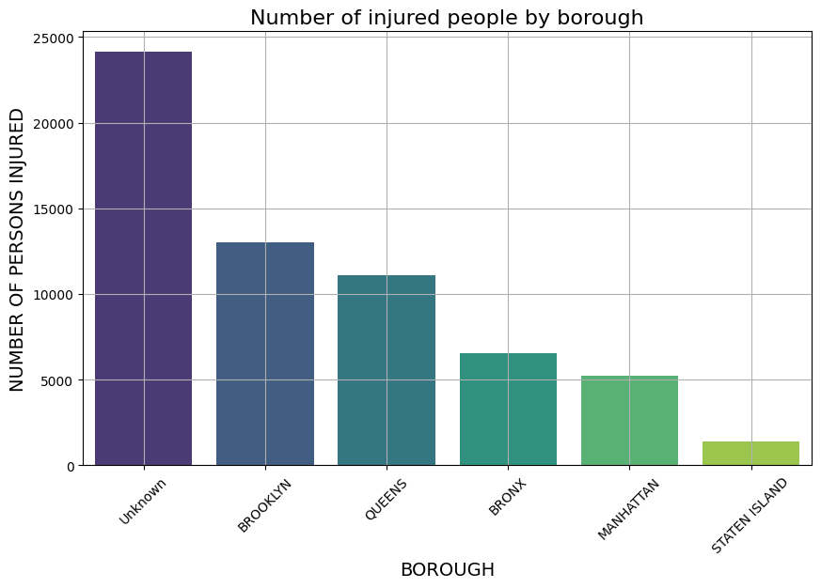
Traffic Collisions in NYC

Slide 13
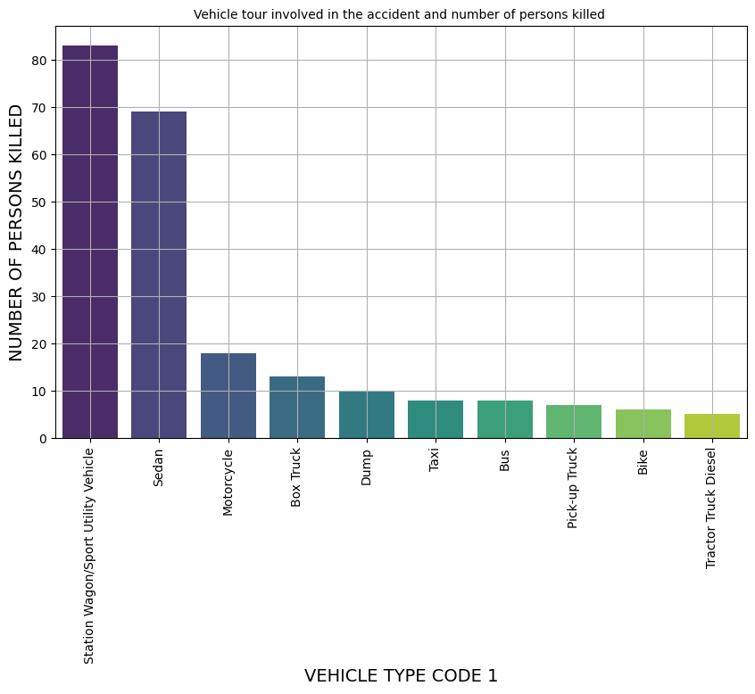
Traffic Collisions in NYC

Slide 14
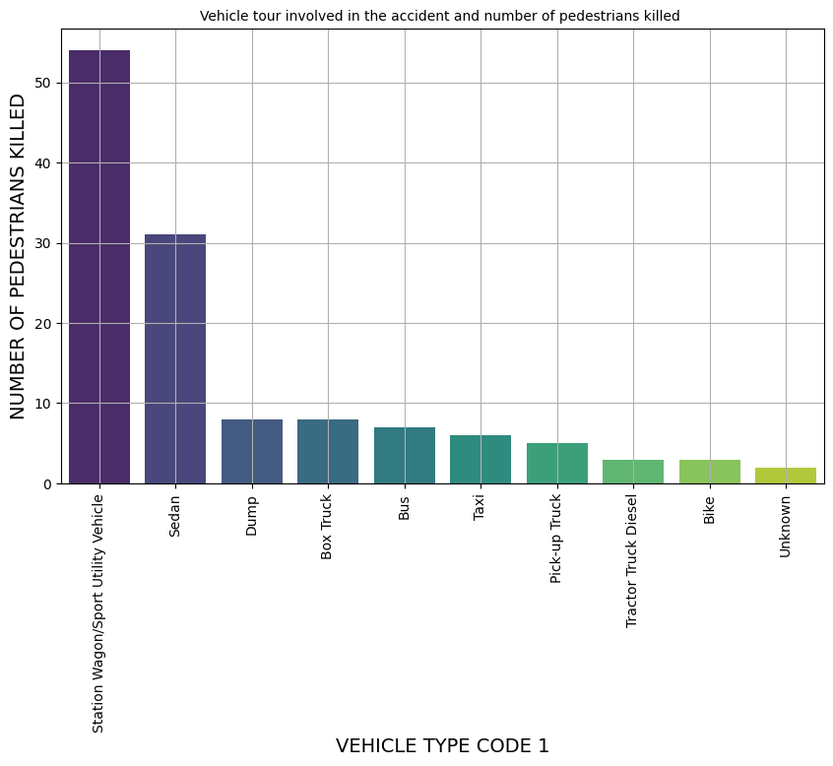
Traffic Collisions in NYC

Slide 15
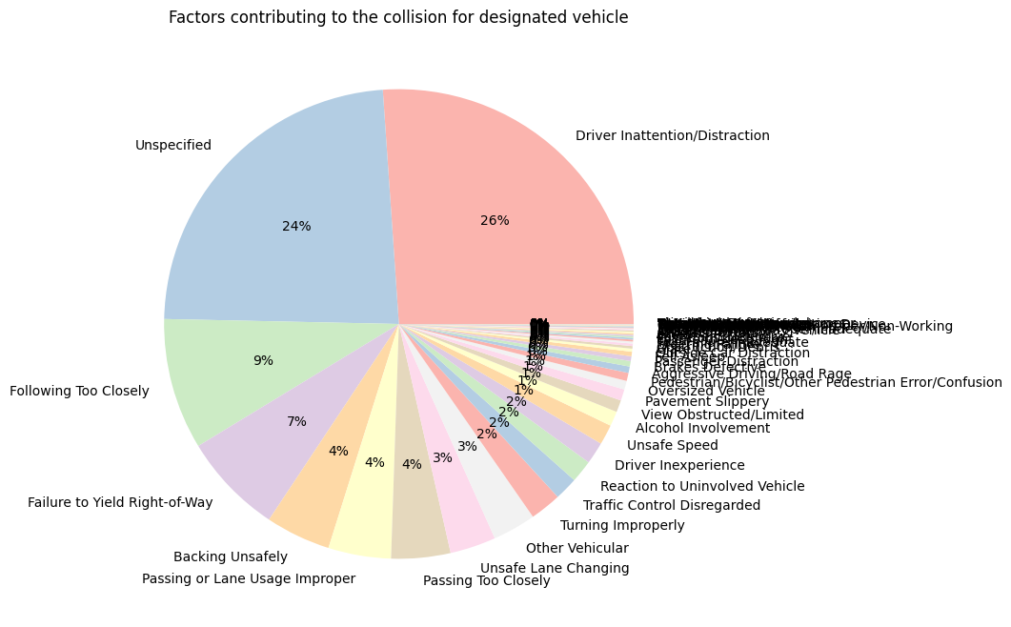
Traffic Collisions in NYC

Slide 16
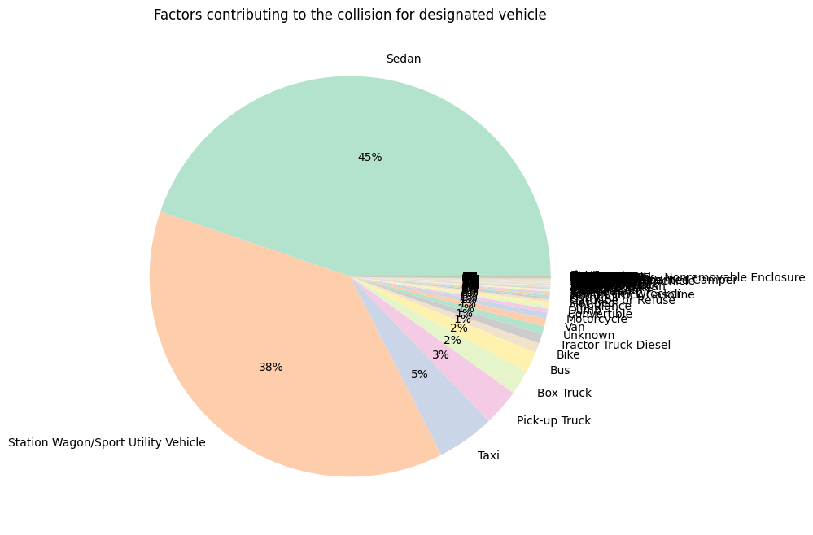
Traffic Collisions in NYC

Slide 17

Conclusion
To conclude this project, we identified and carried out a series of visualizations on a collection of data sets using Python, MongoDB and PostgreSQL and we tried to find some insight knowledge about the traffic in NYC.

